Slide 1
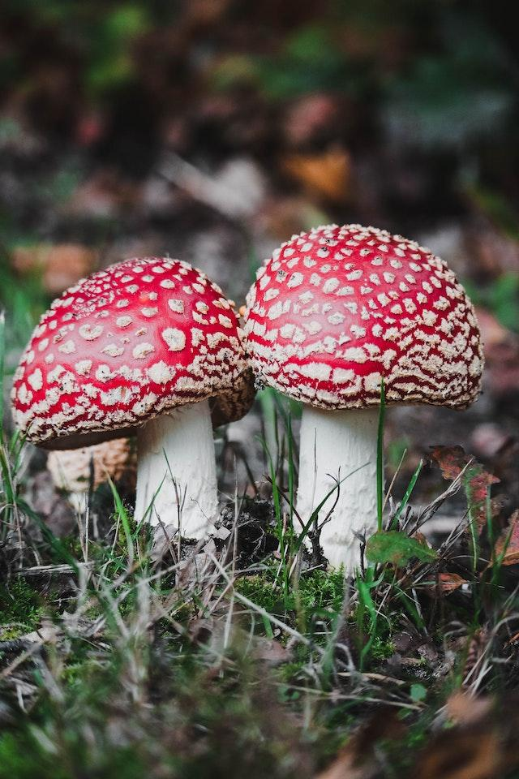
Mushroom Classification
Safe to eat or deadly poison?
By: Summer Harik
Anna Reed
Marquis Sills

Slide 2
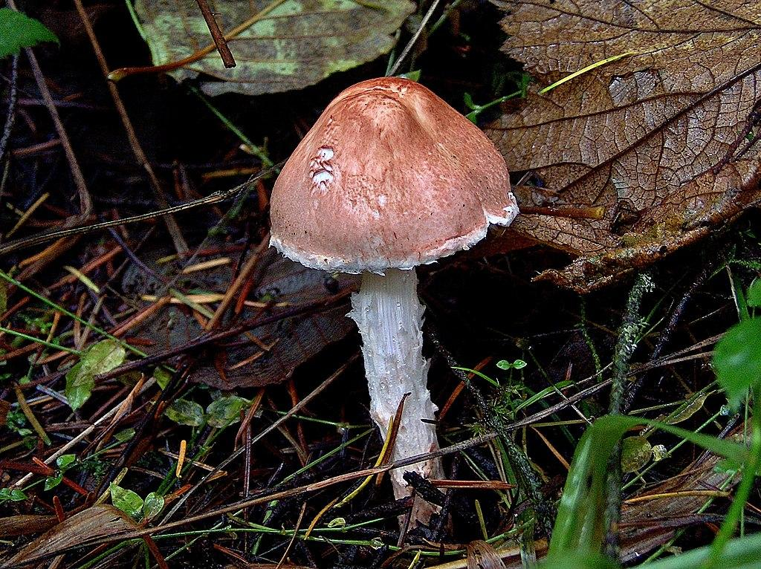
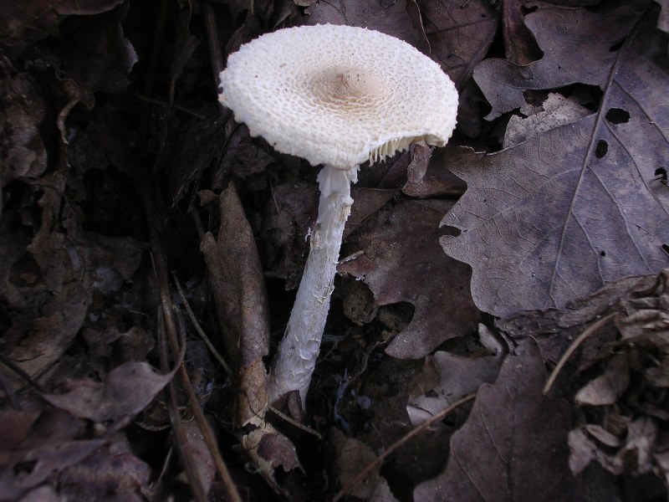
Data Context
This dataset consists of over 8,000 different species of gilled mushrooms in the Agaricus and Lepiota Family Mushroom drawn from The Audubon Society Field Guide to North American Mushrooms. Each species are categorized by either poisonous or edible. The dataset has 23 columns that describe the features of the mushrooms such as odor, bell-shape, and habitat.

Slide 3
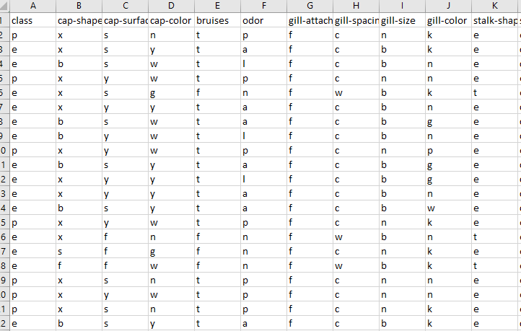
The Goal:
- Can we train our model to determine whether the mushroom is poisonous or edible?
- Are there specific descriptors that heavily impact the model?

Slide 4
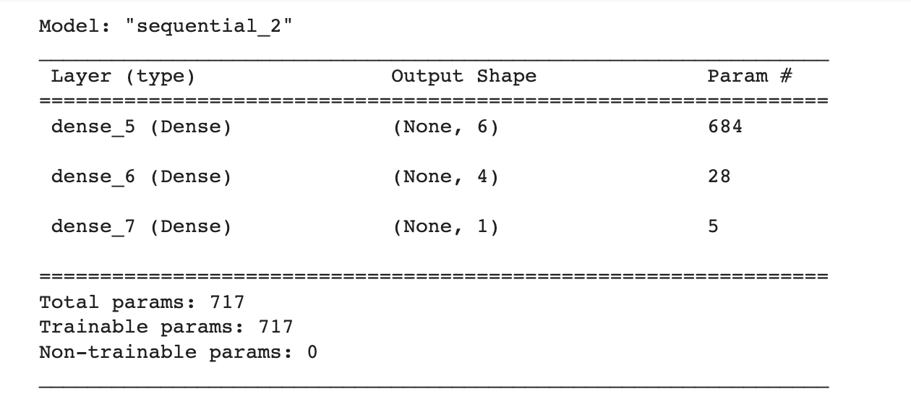
Neural Network
The neural network model received an accuracy score of 100%.

Slide 5
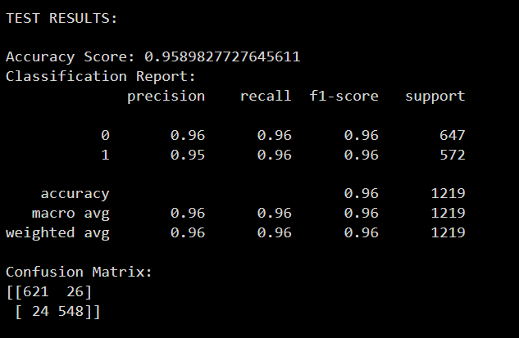
Logistic Regression
Both the testing results and training results had an accuracy score of 95.9%

Slide 6
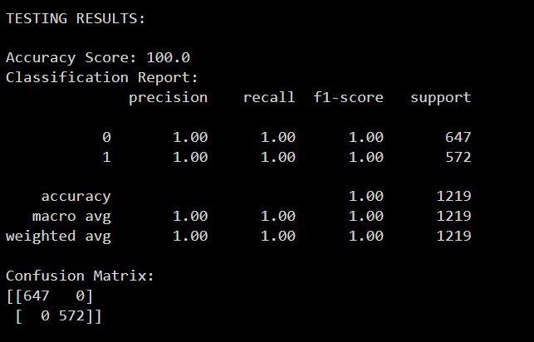
Decision Tree
Both the training data and testing data received a 100% accuracy score

Slide 7
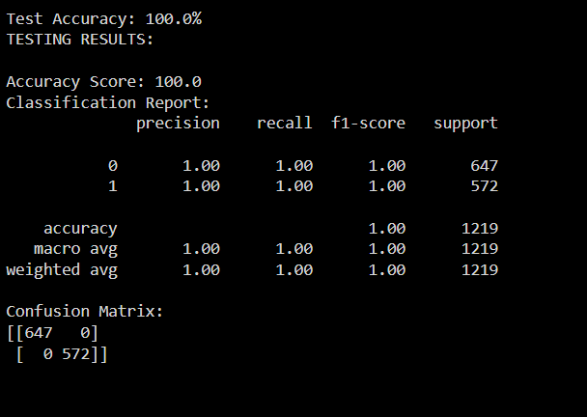
Random Forest
Both the testing data and training data had a 100% accuracy score

Slide 8
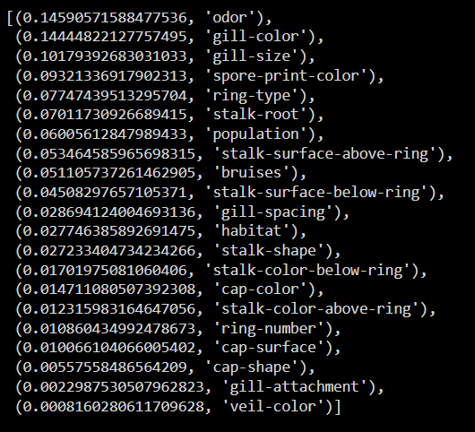
Importances
- Top three factors are odor, gill color and gill size
- Bottom three factors are cap shape, gill attachment and veil color
- Removing these columns from our tests yielded the same results

Slide 9
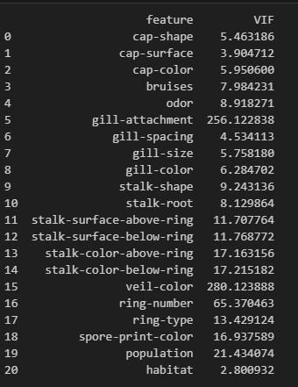
Variance Inflation Factor (VIF)
Multicollinearity: Variables that highly correlated to one another can also.
One way to detect multicollinearity is by using a statistical technique called variance inflation factor (VIF). This measures the strength of correlation between the explanatory variables.
Rule of Thumb:
If the VIF is greater than 5 there is higher correlation for that variable.

Slide 10

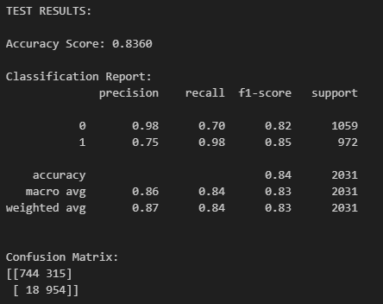
New Logistic Regression

Slide 11
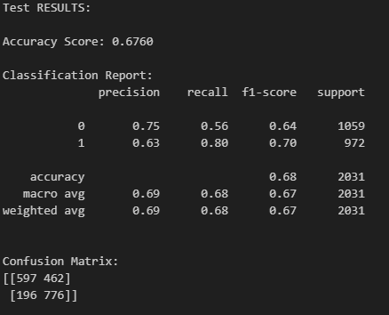
New Decision Tree

Slide 12
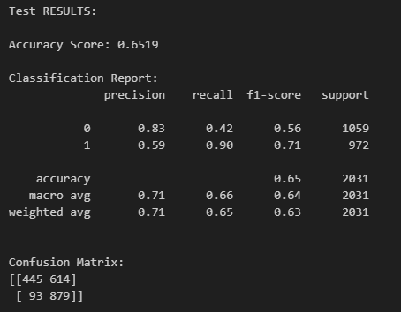
New Random Forest

Slide 13
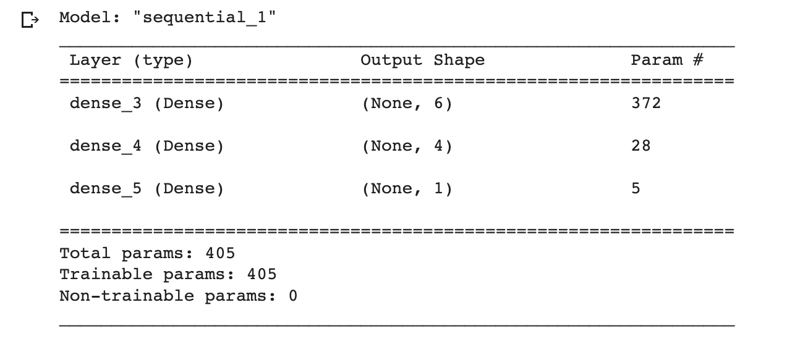
Neural Network 2
The updated neural network model also received an accuracy score of 100%.

